Slide 1
Entity-Relationship Model

Slide 2
Entity-Relationship Model
Design Process
Modeling
Constraints
E-R Diagram
Design Issues
Weak Entity Sets
Extended E-R Features
Design of the Bank Database
Reduction to Relation Schemas
Database Design
UML

Slide 3
Modeling
A database can be modeled as:
  a collection of entities,
  relationship among entities.
An entity is an object that exists and is distinguishable from other objects.
  Example: specific person, company, event, plant
Entities have attributes
  Example: people have names and addresses
An entity set is a set of entities of the same type that share the same properties.
  Example: set of all persons, companies, trees, holidays

Slide 4
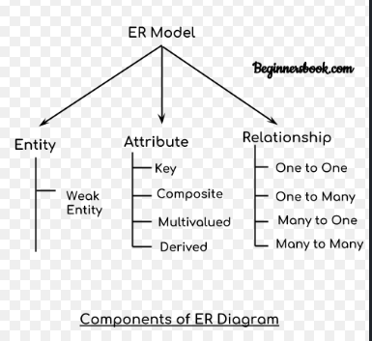

Slide 5
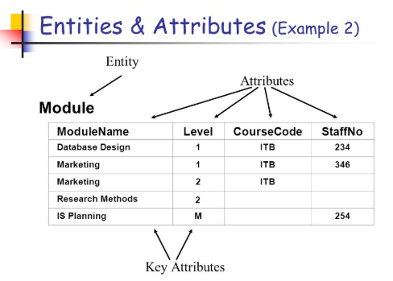

Slide 6
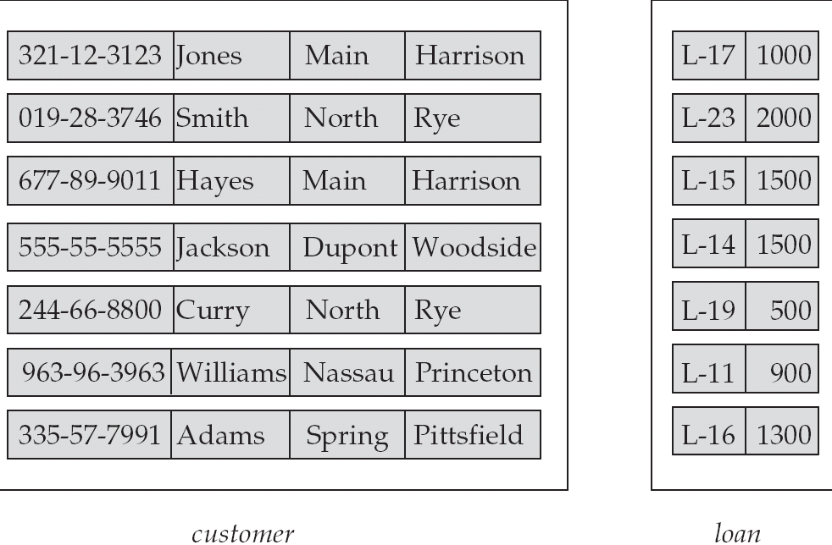
Entity Sets customer and loan
customer_id customer_ customer_ customer_ loan_ amount
name street city number

Slide 7
Relationship Sets
A relationship is an association among several entities
Example:
Hayes depositor A-102
customer entity relationship set account entity
A relationship set is a mathematical relation among n ≥ 2 entities, each taken from entity sets
{(e₁, e₂, … e_{n}) | e₁ ∈ E₁, e₂ ∈ E₂, …, e_{n} ∈ E_{n}}
where (e₁, e₂, …, e_{n}) is a relationship
  Example:
  (Hayes, A-102) ∈ depositor

Slide 8
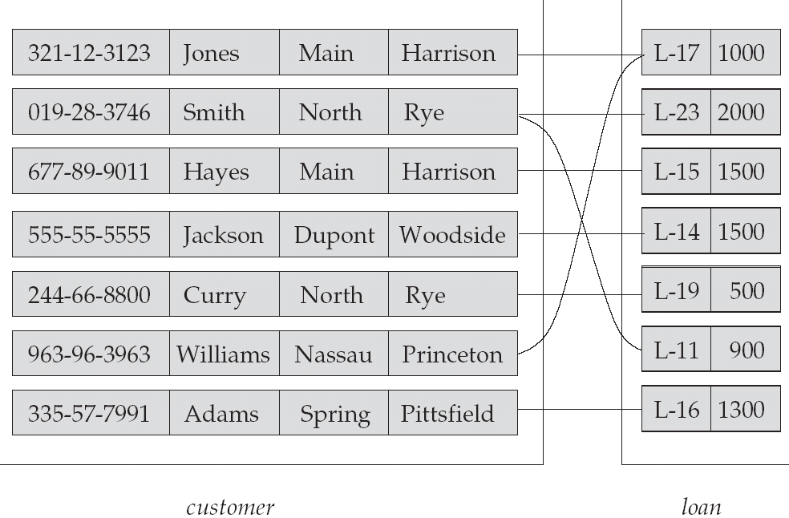
Relationship Set borrower

Slide 9
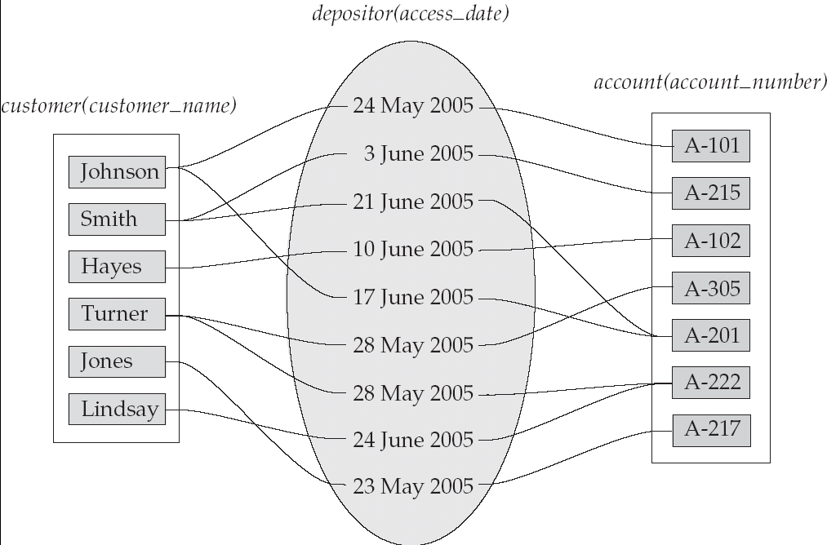
Relationship Sets (Cont.)
An attribute can also be property of a relationship set.
For instance, the depositor relationship set between entity sets customer and account may have the attribute access-date

Slide 10
Degree of a Relationship Set
Refers to number of entity sets that participate in a relationship set.
Relationship sets that involve two entity sets are binary (or degree two). Generally, most relationship sets in a database system are binary.
Relationship sets may involve more than two entity sets.
Relationships between more than two entity sets are rare. Most relationships are binary. (More on this later.)
  Example: Suppose employees of a bank may have jobs (responsibilities) at multiple branches, with different jobs at different branches. Then there is a ternary relationship set between entity sets employee, job, and branch

Slide 11
Attributes
An entity is represented by a set of attributes, that is descriptive properties possessed by all members of an entity set.
Domain – the set of permitted values for each attribute
Attribute types:
  Simple and composite attributes.
  Single-valued and multi-valued attributes
    Example: multivalued attribute: phone_numbers
  Derived attributes
    Can be computed from other attributes
    Example: age, given date_of_birth
Example:
customer = (customer_id, customer_name, customer_street, customer_city )
loan = (loan_number, amount )

Slide 12
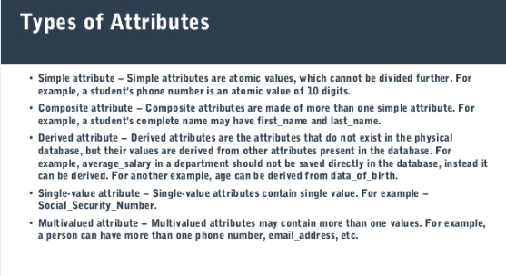

Slide 13
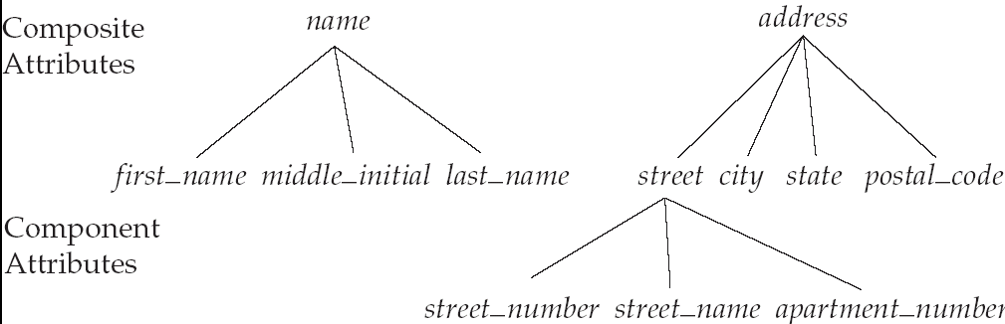
Composite Attributes

Slide 14
Mapping Cardinality Constraints
Express the number of entities to which another entity can be associated via a relationship set.
Most useful in describing binary relationship sets.
For a binary relationship set the mapping cardinality must be one of the following types:
  One to one
  One to many
  Many to one
  Many to many

Slide 15
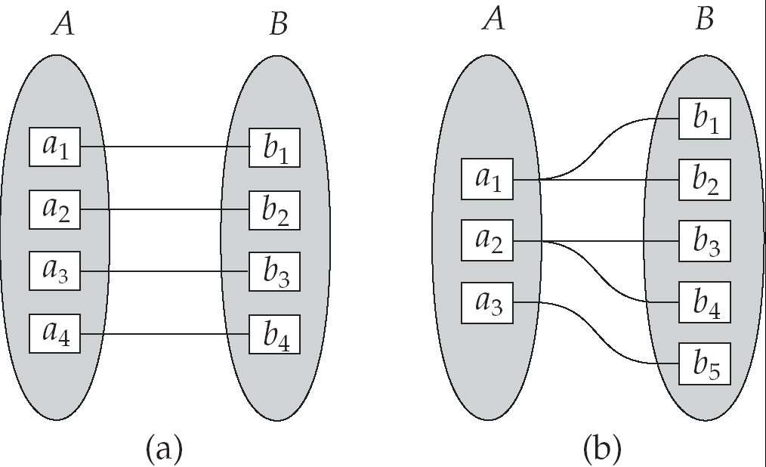
Mapping Cardinalities
One to one
One to many
Note: Some elements in A and B may not be mapped to any
elements in the other set

Slide 16
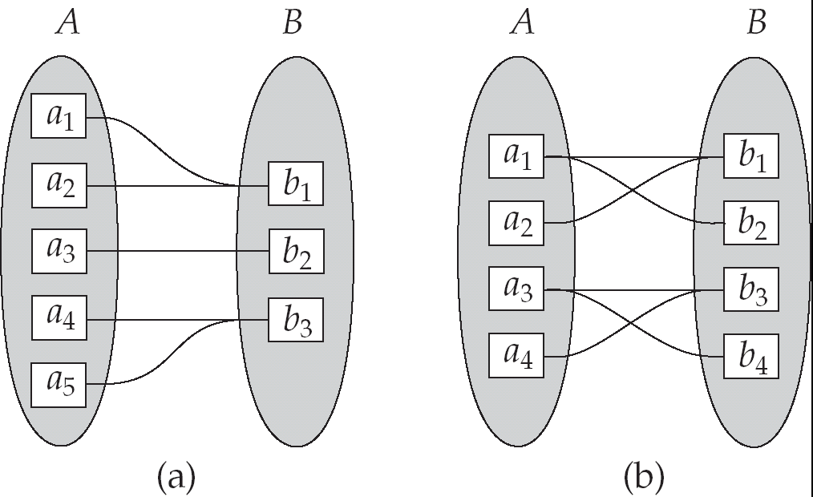
Mapping Cardinalities
Many to one
Many to many
Note: Some elements in A and B may not be mapped to any
elements in the other set

Slide 17
Keys
A super key of an entity set is a set of one or more attributes whose values uniquely determine each entity.
A candidate key of an entity set is a minimal super key
  Customer_id is candidate key of customer
  account_number is candidate key of account
Although several candidate keys may exist, one of the candidate keys is selected to be the primary key.

Slide 18
Keys for Relationship Sets
The combination of primary keys of the participating entity sets forms a super key of a relationship set.
  (customer_id, account_number) is the super key of depositor
  NOTE: this means a pair of entity sets can have at most one relationship in a particular relationship set.
    Example: if we wish to track all access_dates to each account by each customer, we cannot assume a relationship for each access. We can use a multivalued attribute though
Must consider the mapping cardinality of the relationship set when deciding what are the candidate keys
Need to consider semantics of relationship set in selecting the primary key in case of more than one candidate key

Slide 19
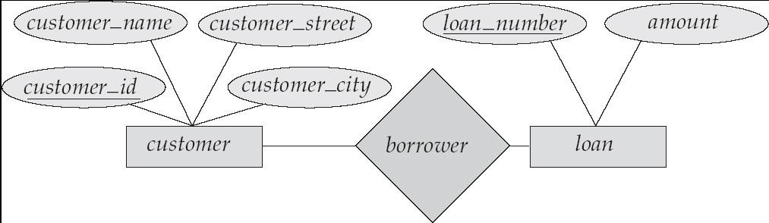
E-R Diagrams
Rectangles represent entity sets.
Diamonds represent relationship sets.
Lines link attributes to entity sets and entity sets to relationship sets.
Ellipses represent attributes
  Double ellipses represent multivalued attributes.
  Dashed ellipses denote derived attributes.
Underline indicates primary key attributes (will study later)

Slide 20
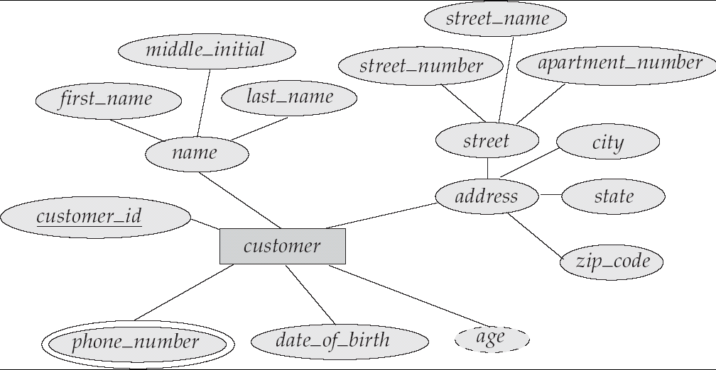
E-R Diagram With Composite, Multivalued, and Derived Attributes

Slide 21
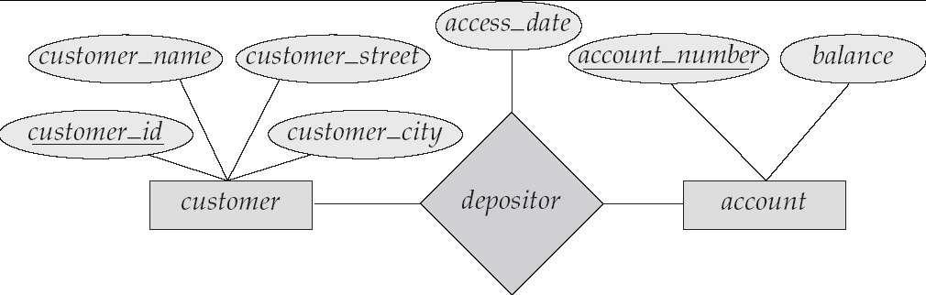
Relationship Sets with Attributes

Slide 22
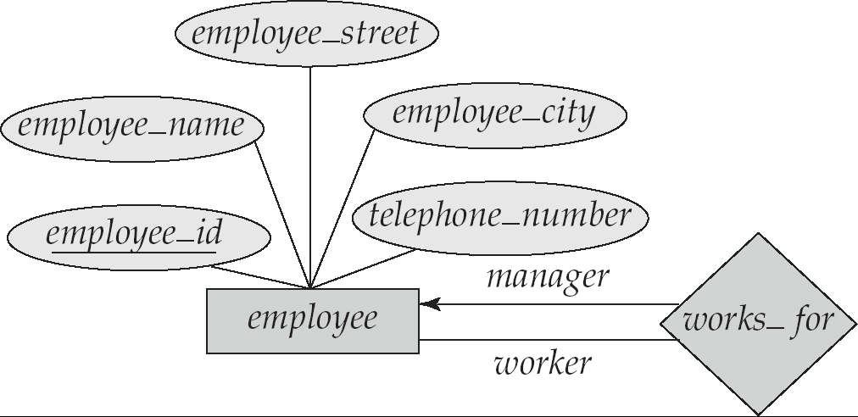
Roles
Entity sets of a relationship need not be distinct
The labels “manager” and “worker” are called roles; they specify how employee entities interact via the works_for relationship set.
Roles are indicated in E-R diagrams by labeling the lines that connect diamonds to rectangles.
Role labels are optional, and are used to clarify semantics of the relationship

Slide 23
Cardinality Constraints
We express cardinality constraints by drawing either a directed line (→), signifying “one,” or an undirected line (—), signifying “many,” between the relationship set and the entity set.
One-to-one relationship:
  A customer is associated with at most one loan via the relationship borrower
  A loan is associated with at most one customer via borrower

Slide 24

One-To-Many Relationship
In the one-to-many relationship a loan is associated with at most one customer via borrower, a customer is associated with several (including 0) loans via borrower

Slide 25
Many-To-One Relationships
In a many-to-one relationship a loan is associated with several (including 0) customers via borrower, a customer is associated with at most one loan via borrower

Slide 26

Many-To-Many Relationship
A customer is associated with several (possibly 0) loans via borrower
A loan is associated with several (possibly 0) customers via borrower

Slide 27
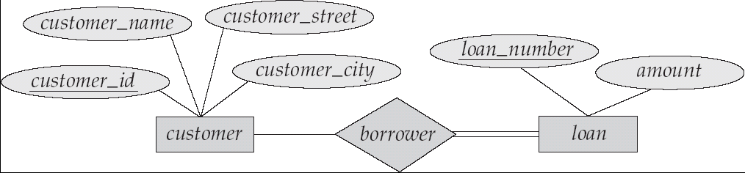
Participation of an Entity Set in a Relationship Set
Total participation (indicated by double line): every entity in the entity set participates in at least one relationship in the relationship set
  E.g. participation of loan in borrower is total
    every loan must have a customer associated to it via borrower
Partial participation: some entities may not participate in any relationship in the relationship set
  Example: participation of customer in borrower is partial

Slide 28
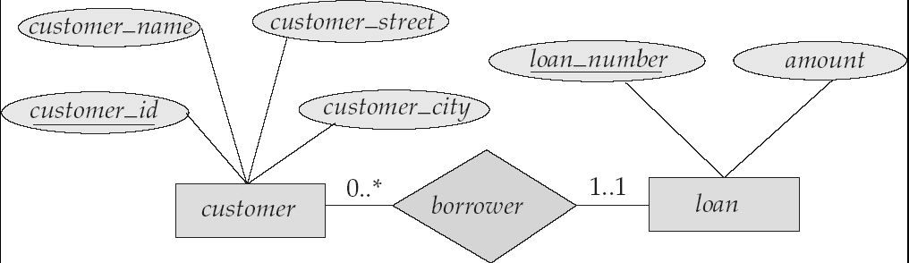
Alternative Notation for Cardinality Limits
Cardinality limits can also express participation constraints

Slide 29
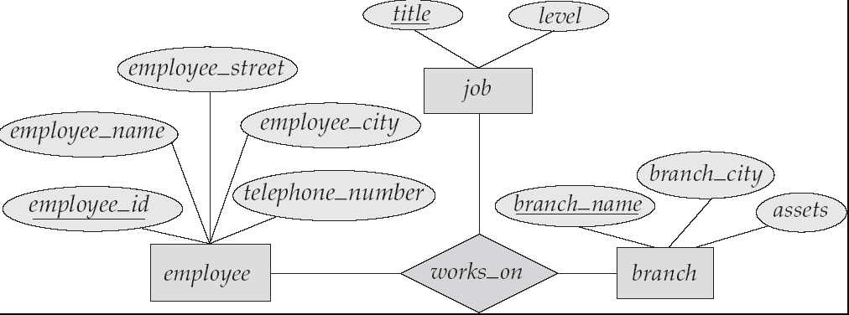
E-R Diagram with a Ternary Relationship

Slide 30
Weak Entity Sets
An entity set that does not have a primary key is referred to as a weak entity set.
The existence of a weak entity set depends on the existence of a identifying entity set
  it must relate to the identifying entity set via a total, one-to-many relationship set from the identifying to the weak entity set
  Identifying relationship depicted using a double diamond
The discriminator (or partial key) of a weak entity set is the set of attributes that distinguishes among all the entities of a weak entity set.
The primary key of a weak entity set is formed by the primary key of the strong entity set on which the weak entity set is existence dependent, plus the weak entity set’s discriminator.

Slide 31
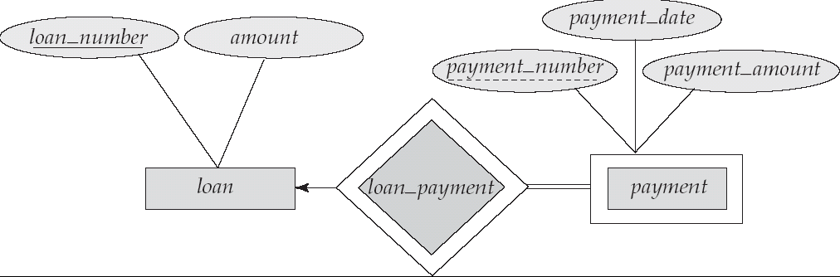
Weak Entity Sets (Cont.)
We depict a weak entity set by double rectangles.
We underline the discriminator of a weak entity set with a dashed line.
payment_number – discriminator of the payment entity set
Primary key for payment – (loan_number, payment_number)

Slide 32
Weak Entity Sets (Cont.)
Note: the primary key of the strong entity set is not explicitly stored with the weak entity set, since it is implicit in the identifying relationship.
If loan_number were explicitly stored, payment could be made a strong entity, but then the relationship between payment and loan would be duplicated by an implicit relationship defined by the attribute loan_number common to payment and loan

Slide 33
More Weak Entity Set Examples
In a university, a course is a strong entity and a course_offering can be modeled as a weak entity
The discriminator of course_offering would be semester (including year) and section_number (if there is more than one section)
If we model course_offering as a strong entity we would model course_number as an attribute.
Then the relationship with course would be implicit in the course_number attribute

Slide 34
Generalization, Specialization and Aggregation in ER Model
Generalization, Specialization and Aggregation in ER model are used for data abstraction in which abstraction mechanism is used to hide details of a set of objects.

Slide 35
Generalization –
Generalization is the process of extracting common properties from a set of entities and create a generalized entity from it.
It is a bottom-up approach in which two or more entities can be generalized to a higher level entity if they have some attributes in common.
For Example, STUDENT and FACULTY can be generalized to a higher level entity called PERSON
In this case, common attributes like P_NAME, P_ADD become part of higher entity (PERSON) and specialized attributes like S_FEE become part of specialized entity (STUDENT).

Slide 36
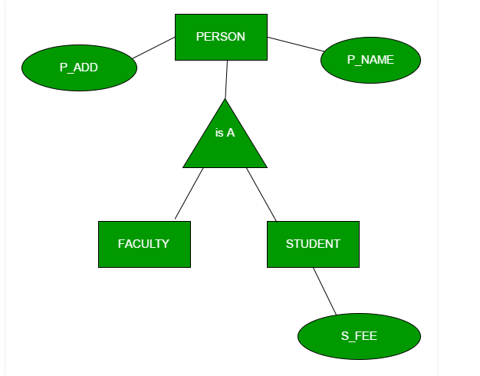

Slide 37
Specialization –
In specialization, an entity is divided into sub-entities based on their characteristics.
It is a top-down approach where higher level entity is specialized into two or more lower level entities.
For Example, EMPLOYEE entity in an Employee management system can be specialized into DEVELOPER, TESTER etc.
In this case, common attributes like E_NAME, E_SAL etc. become part of higher entity (EMPLOYEE) and specialized attributes like TES_TYPE become part of specialized entity (TESTER).

Slide 38
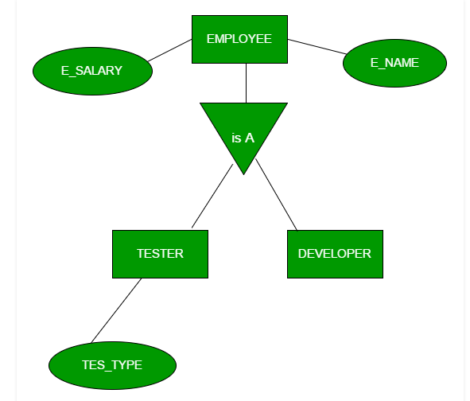

Slide 39
Aggregation –
An ER diagram is not capable of representing relationship between an entity and a relationship which may be required in some scenarios.
In those cases, a relationship with its corresponding entities is aggregated into a higher level entity.
For Example, Employee working for a project may require some machinery. So, REQUIRE relationship is needed between relationship WORKS_FOR and entity MACHINERY.
Using aggregation, WORKS_FOR relationship with its entities EMPLOYEE and PROJECT is aggregated into single entity and relationship REQUIRE is created between aggregated entity and MACHINERY.

Slide 40
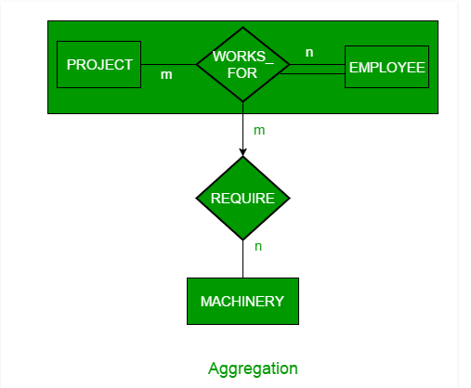

Slide 41
Extended E-R Features: Specialization
Top-down design process; we designate subgroupings within an entity set that are distinctive from other entities in the set.
These subgroupings become lower-level entity sets that have attributes or participate in relationships that do not apply to the higher-level entity set.
Depicted by a triangle component labeled ISA (E.g. customer “is a” person).
Attribute inheritance – a lower-level entity set inherits all the attributes and relationship participation of the higher-level entity set to which it is linked.

Slide 42
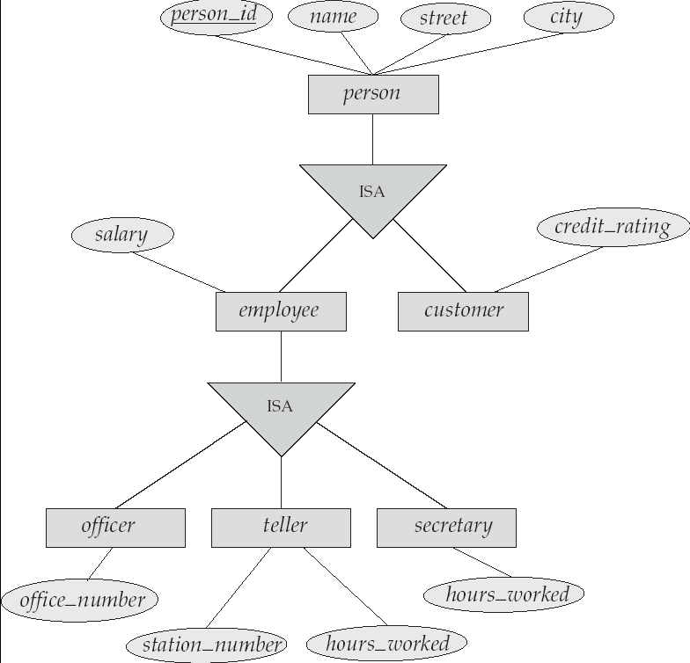
Specialization Example

Slide 43
Extended ER Features: Generalization
A bottom-up design process – combine a number of entity sets that share the same features into a higher-level entity set.
Specialization and generalization are simple inversions of each other; they are represented in an E-R diagram in the same way.
The terms specialization and generalization are used interchangeably.

Slide 44
Specialization and Generalization (Cont.)
Can have multiple specializations of an entity set based on different features.
E.g. permanent_employee vs. temporary_employee, in addition to officer vs. secretary vs. teller
Each particular employee would be
  a member of one of permanent_employee or temporary_employee,
  and also a member of one of officer, secretary, or teller
The ISA relationship also referred to as superclass - subclass relationship

Slide 45
Design Constraints on a Specialization/Generalization
Constraint on which entities can be members of a given lower-level entity set.
  condition-defined
    Example: all customers over 65 years are members of senior-citizen entity set; senior-citizen ISA person.
  user-defined
Constraint on whether or not entities may belong to more than one lower-level entity set within a single generalization.
  Disjoint
    an entity can belong to only one lower-level entity set
    Noted in E-R diagram by writing disjoint next to the ISA triangle
  Overlapping
    an entity can belong to more than one lower-level entity set

Slide 46
Design Constraints on a Specialization/Generalization (Cont.)
Completeness constraint -- specifies whether or not an entity in the higher-level entity set must belong to at least one of the lower-level entity sets within a generalization.
  total : an entity must belong to one of the lower-level entity sets
  partial: an entity need not belong to one of the lower-level entity sets

Slide 47
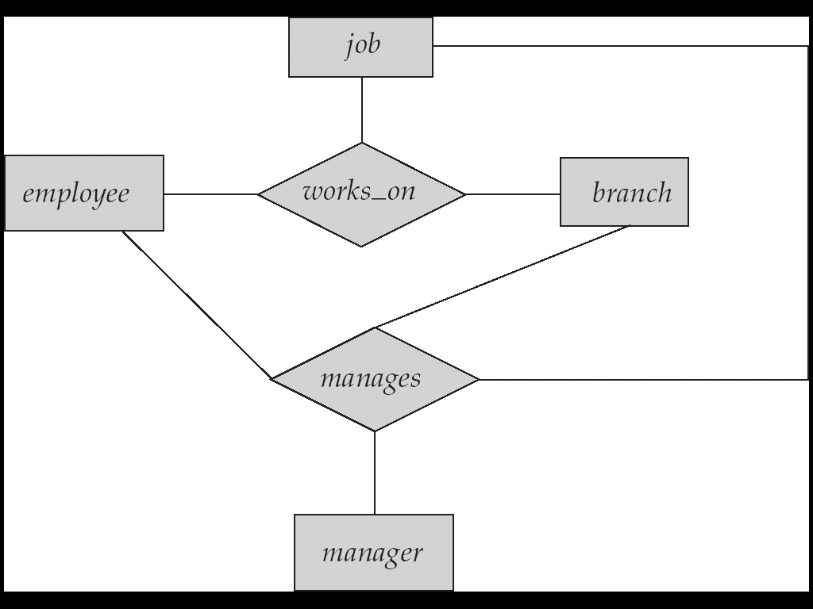
Aggregation
Consider the ternary relationship works_on, which we saw earlier
Suppose we want to record managers for tasks performed by an
employee at a branch

Slide 48
Aggregation (Cont.)
Relationship sets works_on and manages represent overlapping information
  Every manages relationship corresponds to a works_on relationship
  However, some works_on relationships may not correspond to any manages relationships
    So we can’t discard the works_on relationship
Eliminate this redundancy via aggregation
  Treat relationship as an abstract entity
  Allows relationships between relationships
  Abstraction of relationship into new entity
Without introducing redundancy, the following diagram represents:
  An employee works on a particular job at a particular branch
  An employee, branch, job combination may have an associated manager

Slide 49
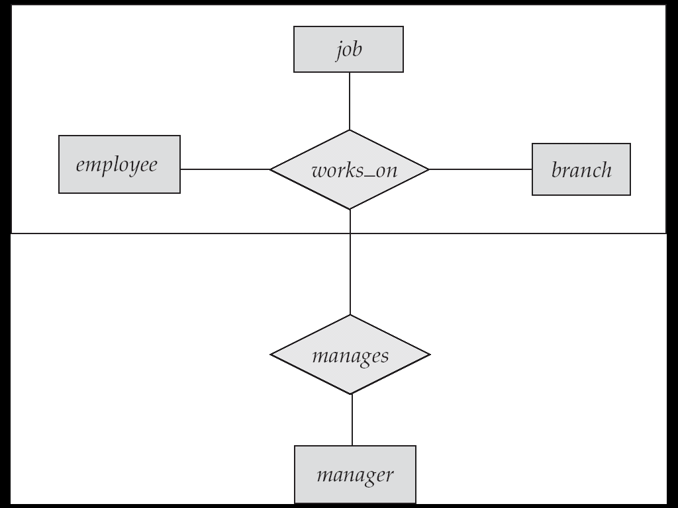
E-R Diagram With Aggregation

Slide 50
E-R Design Decisions
The use of an attribute or entity set to represent an object.
Whether a real-world concept is best expressed by an entity set or a relationship set.
The use of a ternary relationship versus a pair of binary relationships.
The use of a strong or weak entity set.
The use of specialization/generalization – contributes to modularity in the design.
The use of aggregation – can treat the aggregate entity set as a single unit without concern for the details of its internal structure.

Slide 51
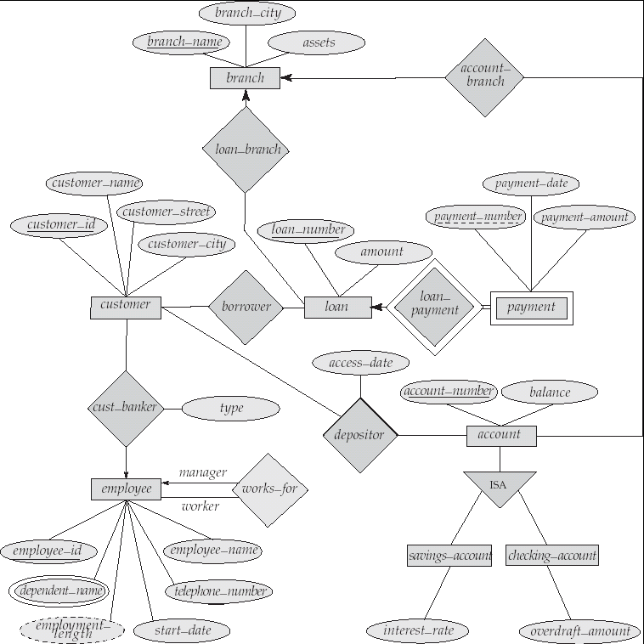
E-R Diagram for a Banking Enterprise

Slide 52
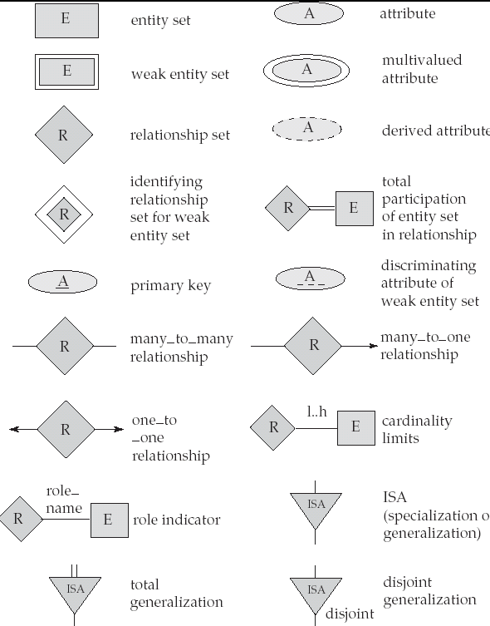
Summary of Symbols Used in E-R Notation

Slide 53

Summary of Symbols (Cont.)

Slide 54
Reduction to Relation Schemas
Primary keys allow entity sets and relationship sets to be expressed uniformly as relation schemas that represent the contents of the database.
A database which conforms to an E-R diagram can be represented by a collection of schemas.
For each entity set and relationship set there is a unique schema that is assigned the name of the corresponding entity set or relationship set.
Each schema has a number of columns (generally corresponding to attributes), which have unique names.

Slide 55
Representing Entity Sets as Schemas
A strong entity set reduces to a schema with the same attributes.
A weak entity set becomes a table that includes a column for the primary key of the identifying strong entity set
payment =
( loan_number, payment_number, payment_date, payment_amount )

Slide 56
Representing Relationship Sets as Schemas
A many-to-many relationship set is represented as a schema with attributes for the primary keys of the two participating entity sets, and any descriptive attributes of the relationship set.
Example: schema for relationship set borrower
borrower = (customer_id, loan_number )

Slide 57

Redundancy of Schemas
Many-to-one and one-to-many relationship sets that are total on the many-side can be represented by adding an extra attribute to the “many” side, containing the primary key of the “one” side
Example: Instead of creating a schema for relationship set account_branch, add an attribute branch_name to the schema arising from entity set account

Slide 58
Redundancy of Schemas (Cont.)
For one-to-one relationship sets, either side can be chosen to act as the “many” side
  That is, extra attribute can be added to either of the tables corresponding to the two entity sets
If participation is partial on the “many” side, replacing a schema by an extra attribute in the schema corresponding to the “many” side could result in null values
The schema corresponding to a relationship set linking a weak entity set to its identifying strong entity set is redundant.
  Example: The payment schema already contains the attributes that would appear in the loan_payment schema (i.e., loan_number and payment_number).

Slide 59
Composite and Multivalued Attributes
Composite attributes are flattened out by creating a separate attribute for each component attribute
  Example: given entity set customer with composite attribute name with component attributes first_name and last_name the schema corresponding to the entity set has two attributes
  name.first_name and name.last_name
A multivalued attribute M of an entity E is represented by a separate schema EM
  Schema EM has attributes corresponding to the primary key of E and an attribute corresponding to multivalued attribute M
  Example: Multivalued attribute dependent_names of employee is represented by a schema:
  employee_dependent_names = ( employee_id, dname)
  Each value of the multivalued attribute maps to a separate tuple of the relation on schema EM
    For example, an employee entity with primary key 123-45-6789 and dependents Jack and Jane maps to two tuples:
    (123-45-6789 , Jack) and (123-45-6789 , Jane)

Slide 60
Representing Specialization via Schemas
Method 1:
  Form a schema for the higher-level entity
  Form a schema for each lower-level entity set, include primary key of higher-level entity set and local attributes
  schema attributes
  person name, street, city
  customer name, credit_rating
  employee name, salary
  Drawback: getting information about, an employee requires accessing two relations, the one corresponding to the low-level schema and the one corresponding to the high-level schema

Slide 61
Representing Specialization as Schemas (Cont.)
Method 2:
  Form a schema for each entity set with all local and inherited attributes
  schema attributes
  person name, street, city
  customer name, street, city, credit_rating
  employee name, street, city, salary
  If specialization is total, the schema for the generalized entity set (person) not required to store information
    Can be defined as a “view” relation containing union of specialization relations
    But explicit schema may still be needed for foreign key constraints
  Drawback: street and city may be stored redundantly for people who are both customers and employees

Slide 62
Schemas Corresponding to Aggregation
To represent aggregation, create a schema containing
  primary key of the aggregated relationship,
  the primary key of the associated entity set
  any descriptive attributes

Slide 63

Schemas Corresponding to Aggregation (Cont.)
For example, to represent aggregation manages between relationship works_on and entity set manager, create a schema
manages (employee_id, branch_name, title, manager_name)
Schema works_on is redundant provided we are willing to store null values for attribute manager_name in relation on schema manages

Slide 64
UML
UML: Unified Modeling Language
UML has many components to graphically model different aspects of an entire software system
UML Class Diagrams correspond to E-R Diagram, but several differences.

Slide 65
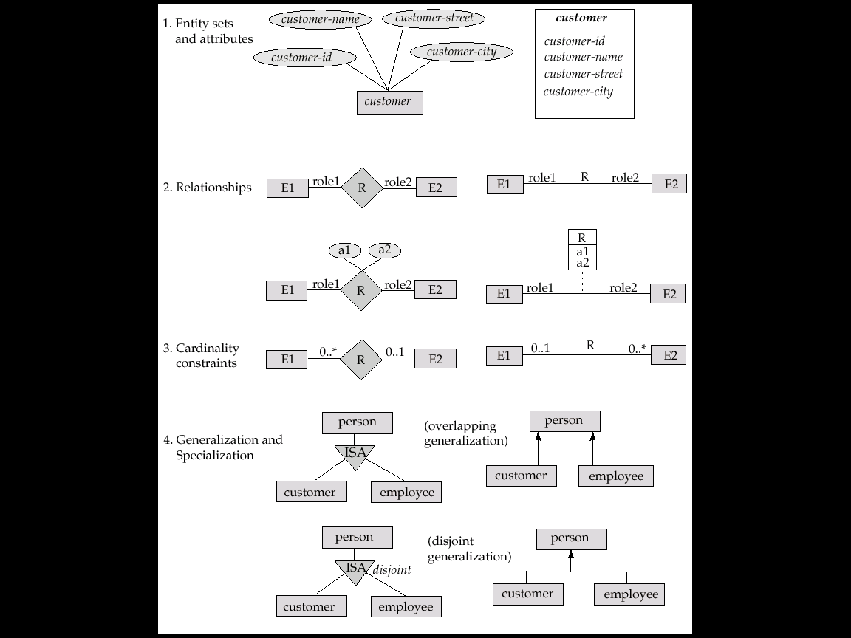
Summary of UML Class Diagram Notation

Slide 66
UML Class Diagrams (Cont.)
Entity sets are shown as boxes, and attributes are shown within the box, rather than as separate ellipses in E-R diagrams.
Binary relationship sets are represented in UML by just drawing a line connecting the entity sets. The relationship set name is written adjacent to the line.
The role played by an entity set in a relationship set may also be specified by writing the role name on the line, adjacent to the entity set.
The relationship set name may alternatively be written in a box, along with attributes of the relationship set, and the box is connected, using a dotted line, to the line depicting the relationship set.
Non-binary relationships drawn using diamonds, just as in ER diagrams

Slide 67
UML Class Diagram Notation (Cont.)
overlapping
disjoint
*Note reversal of position in cardinality constraint depiction
*Generalization can use merged or separate arrows independent
of disjoint/overlapping

Slide 68
UML Class Diagrams (Contd.)
Cardinality constraints are specified in the form l..h, where l denotes the minimum and h the maximum number of relationships an entity can participate in.
Beware: the positioning of the constraints is exactly the reverse of the positioning of constraints in E-R diagrams.
The constraint 0..* on the E2 side and 0..1 on the E1 side means that each E2 entity can participate in at most one relationship, whereas each E1 entity can participate in many relationships; in other words, the relationship is many to one from E2 to E1.
Single values, such as 1 or * may be written on edges; The single value 1 on an edge is treated as equivalent to 1..1, while * is equivalent to 0..*.

Slide 69
End of Chapter 2

Slide 70
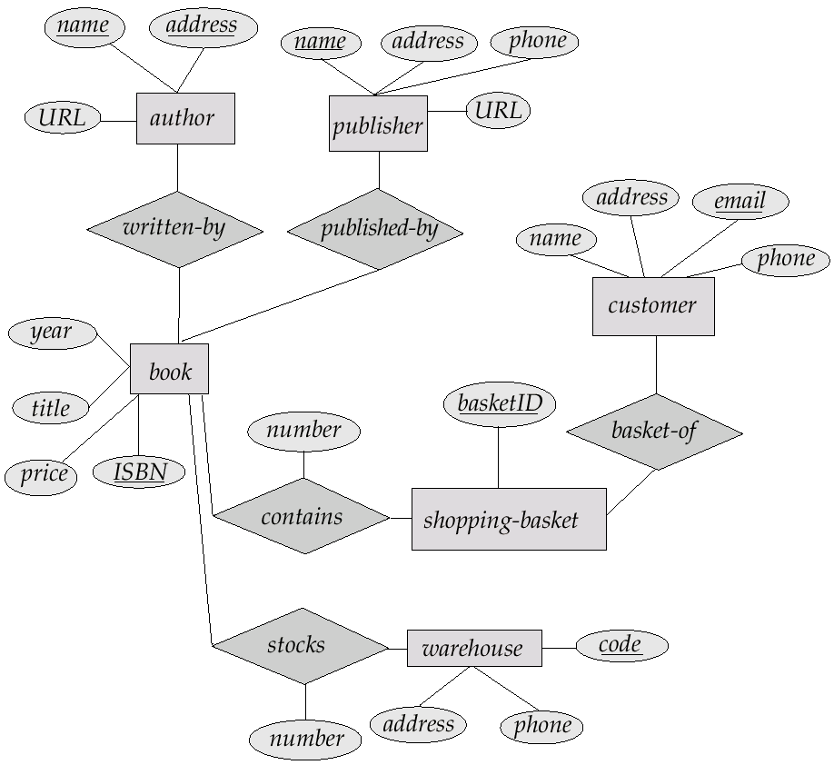
E-R Diagram for Exercise 2.10

Slide 71

E-R Diagram for Exercise 2.15

Slide 72
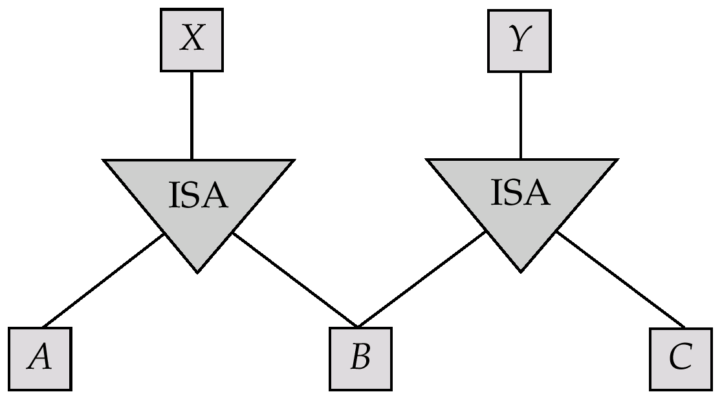
E-R Diagram for Exercise 2.22

Slide 73
E-R Diagram for Exercise 2.15

Slide 74
Existence Dependencies
If the existence of entity x depends on the existence of entity y, then x is said to be existence dependent on y.
  y is a dominant entity (in example below, loan)
  x is a subordinate entity (in example below, payment)
loan-payment
loan
payment
If a loan entity is deleted, then all its associated payment entities must be deleted also.

Slide 75
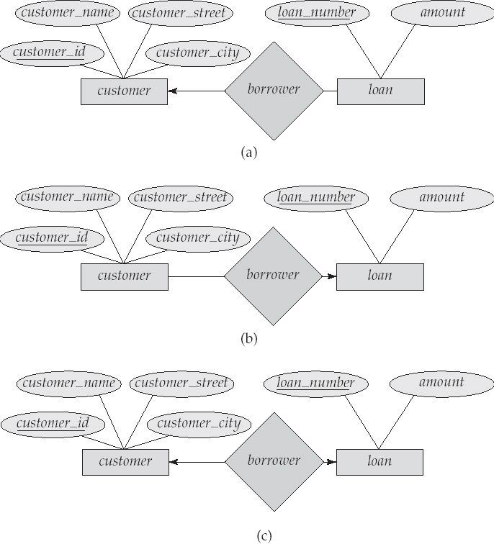
Figure 6.8

Slide 76
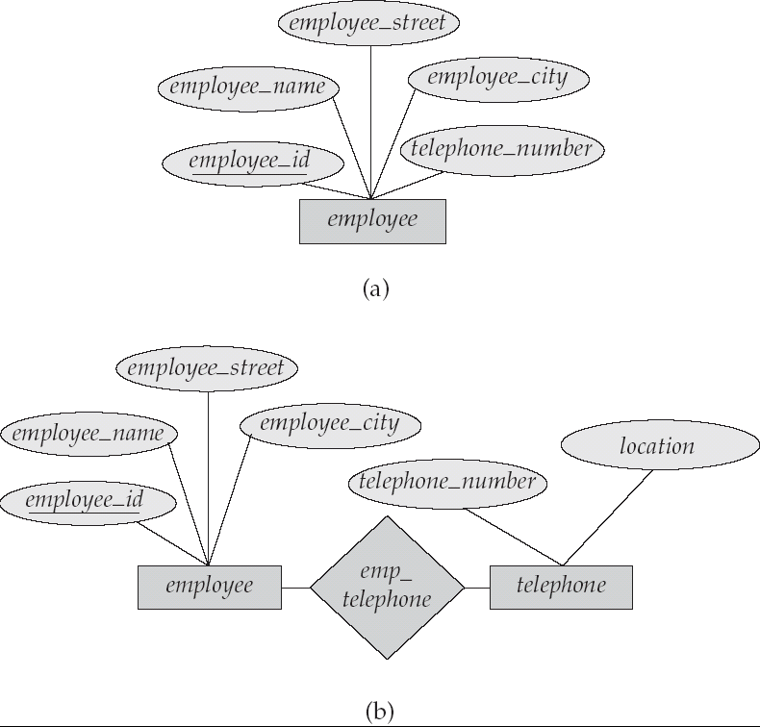
Figure 6.15

Slide 77
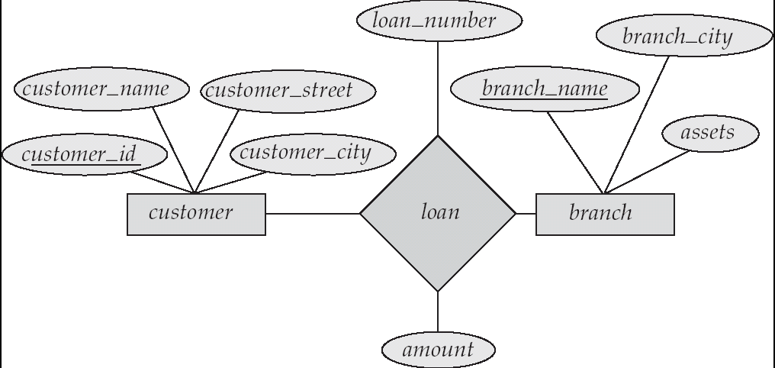
Figure 6.16

Slide 78
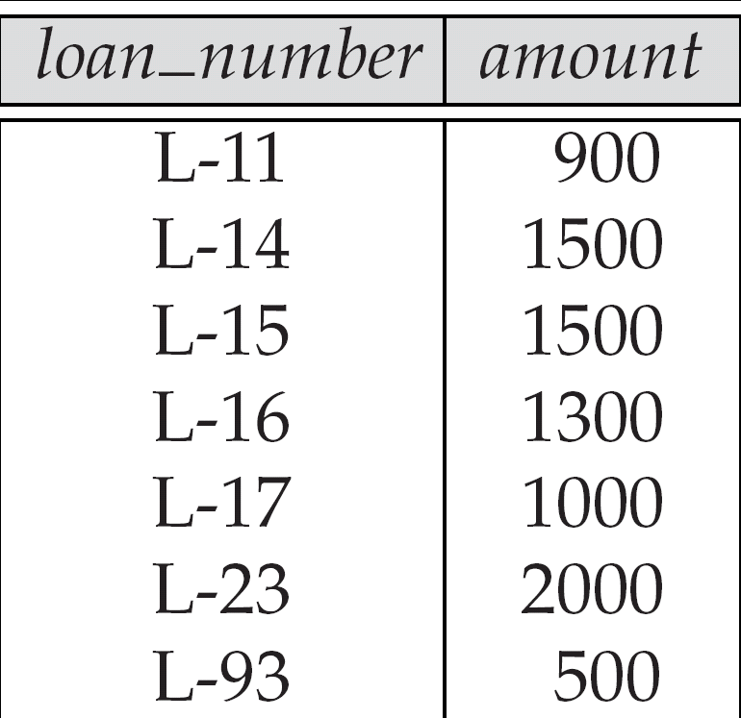
Figure 6.26

Slide 79
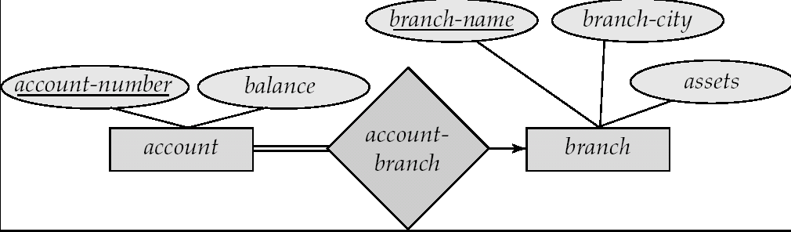
Figure 6.27

Slide 80
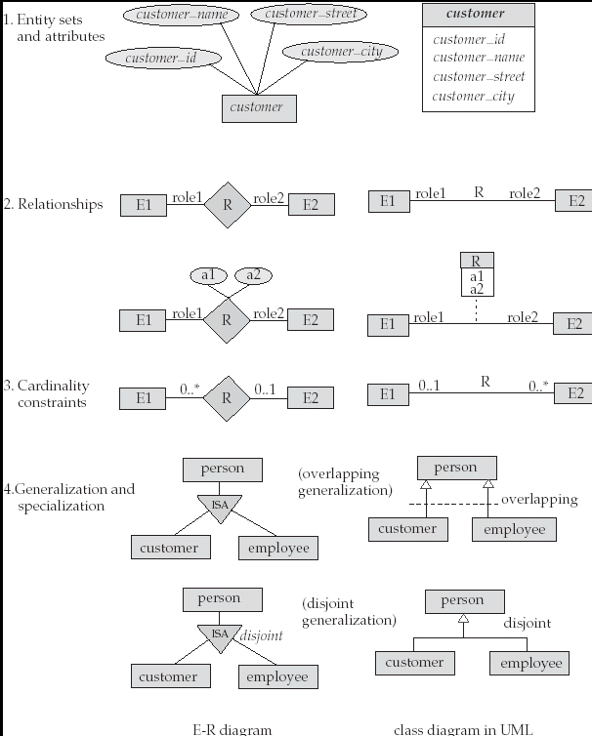
Figure 6.28

Slide 81
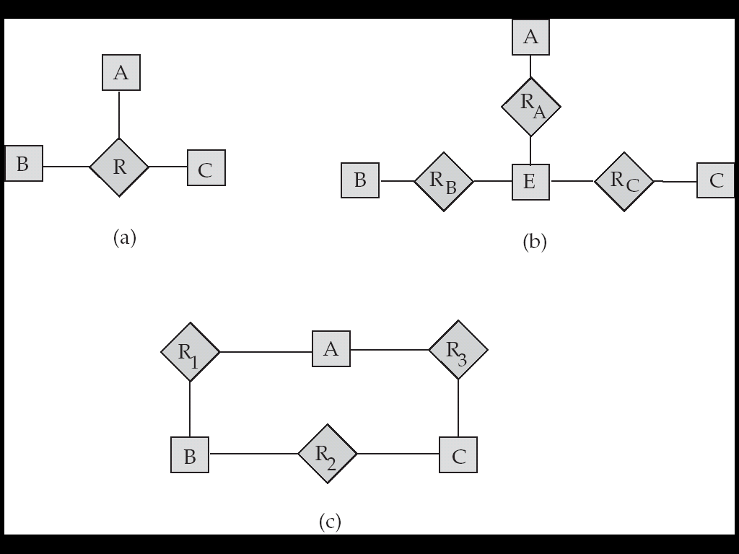
Figure 6.29

Slide 82
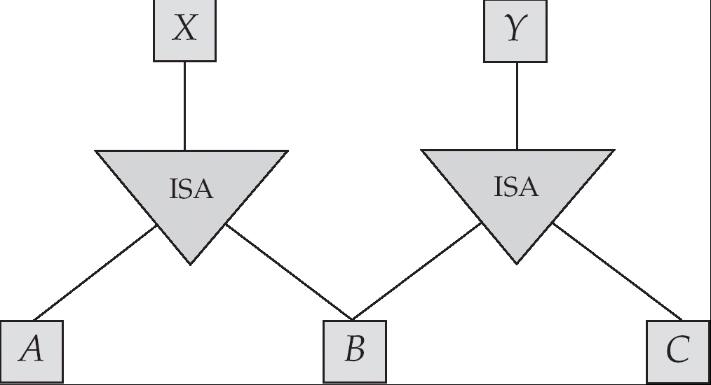
Figure 6.30

Slide 83
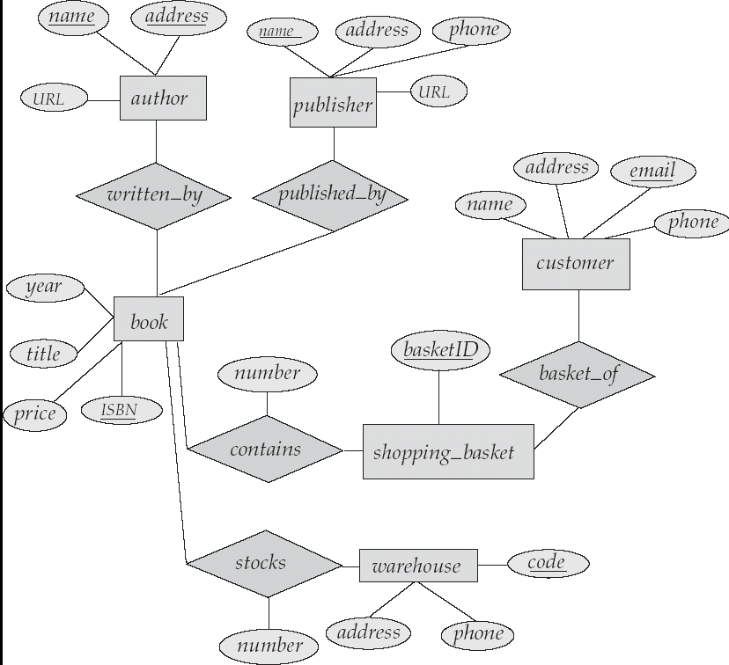
Figure 6.31

Slide 84
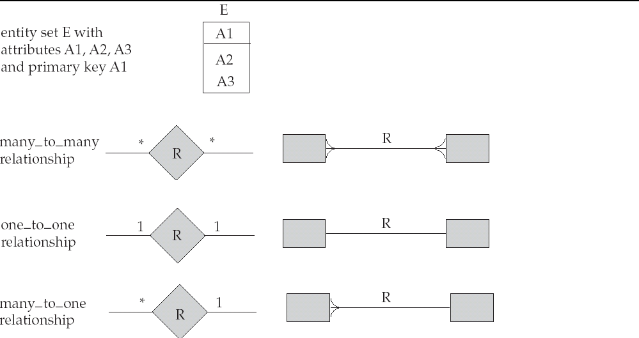
Alternative E-R Notations
Figure 6.24

